Slide 1
AI for GitHub: A View from Next
Don Syme (dsyme@github.com)
Principal Researcher, GitHub Next

Slide 2

GitHub Next
Researching the future of software development
githubnext.com

Slide 3
TLDR
The big game is using LLMs to bring assists to dev activities.
Many possible assists
Many different activities
Delivery in editor, monolith, application and command line
LLMs are probabilistic text calculators
Text in, text out.
Key topics: prompts, context, control, quality, divide-and-conquer, hallucination.
LLMs are magical but difficult functions to integrate in high-trust scenarios.
Scepticism is healthy. Almost nothing but search in github.com today is probabilistic.
The human is almost certainly in-the-loop.

Slide 4
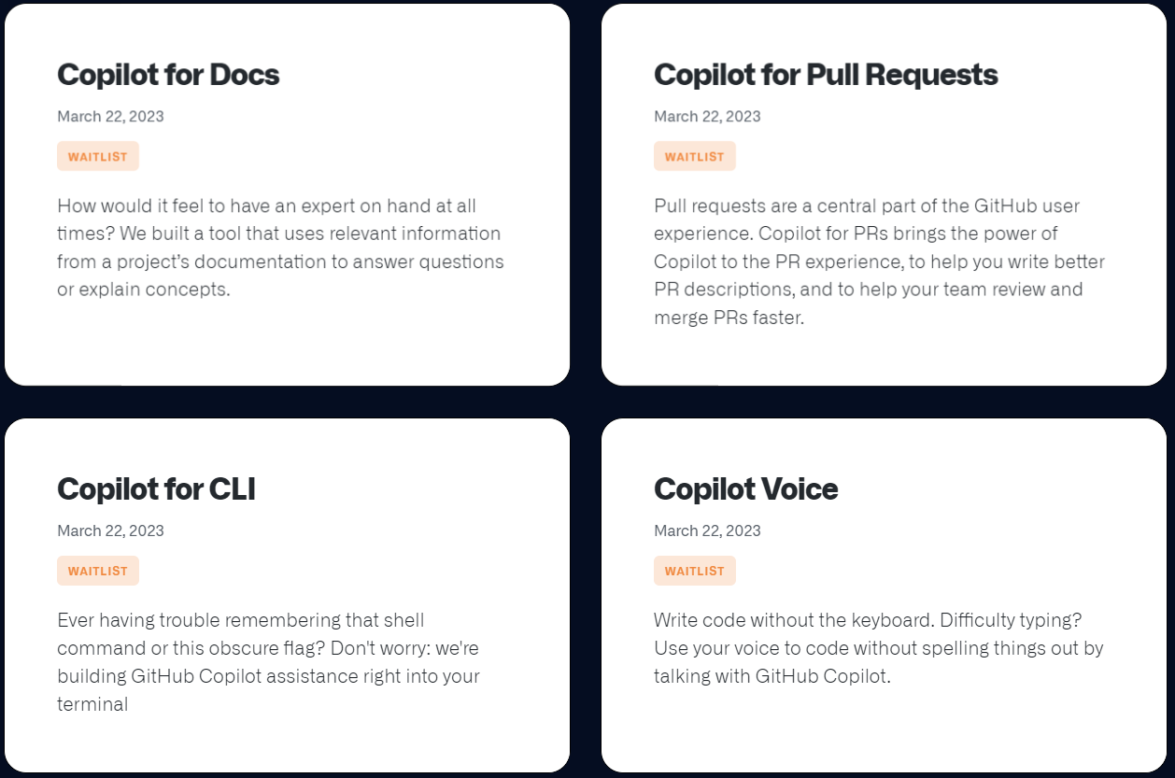
Announced yesterday!

Slide 5
What is needed to contribute?
Understand the rationale and business case
Get some hands-on experience with LLMs, esp GPT-3/4
Get in a playground and try things out. Be sceptical, push the limits. Put some code in as input and output. Invoke from APIs and build an understanding of latencies, costs, reliability.
Understand the design principles
I’ll outline my view of some of these. There are other excellent resources. Develop your own point of view.
Get familiar with an end-to-end AI codebase for service and UX
Several available. QA, telemetry, nature of workloads etc.
Learn about Responsible AI and other training topics.

Slide 6
Sample Repo (Copilot4PRs)
Learn about it from the AI generated summaries!
github.com/githubnext/prbot
github.com/githubnext/prbot/blob/thumbs/main/.thumbs/thumb.md
Topics of interest
Prompts (e.g. see tests)
Prompt-building for many items
Hierarchical summarization
Test generation
Multi-modal: cmdline, bot, service, vscode
Lots of utilities
QA: telemetry, baselines, scoring, deltas, rapid iteration (local caching of requests)

Slide 7
AI Outputs Overview
Summarization
Indexing
Chat
Generative
Critique

Slide 8
AI Outputs Overview
Summarization
Keywords
Title
Summary
Abstract
Walkthrough
Documentation
Indexing
Chat
Generative
Critique

Slide 9
Summarization: Understand the Rationale
We are headed to a world where much text associated with code/repos is emergent and automatic.
Content ⇒ Search Content ⇒ Text
LLM AI is now able to summarize and explain code and changes pretty well. Analogies:
Abstracts, keywords, summaries, descriptions = for comprehension
Table of contents = for navigation
Documentation, walkthroughs = for explanation
Use cases:
Tool-tips Infopanel content
Seeding human-authored descriptions Search
Most useful for those unfamiliar with the content, or pressed for time, or small-factor devices.
Risks:
Bad UX, Too Much Information, Distracting
Inaccurate, misleading
Too Much Text for non-native speakers

Slide 10
Summarization: Understand the Business Case
Possibilities for $$$
Direct use in UX
Descriptions available everywhere
Monolith
Editor (VSCode, …)
Files, directories, changes, issues, PRs, projects, …
Supporting human
Completions
Editable descriptions and documentation
Explaining the swamp of legacy code - “Undocumented PR from dev 8yr ago”
Feed into other tools

Slide 11
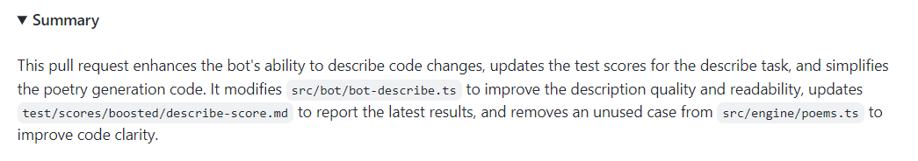
AI Summarization – Example – PR Summary
./prbot describe https://github.com/githubnext/prbot/pull/565

Slide 12
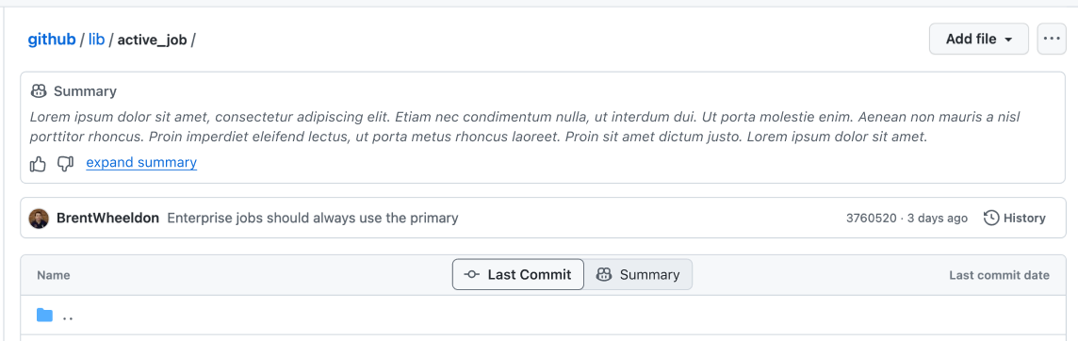
AI Summarization – UX Mockups (EPD Core)

Slide 13
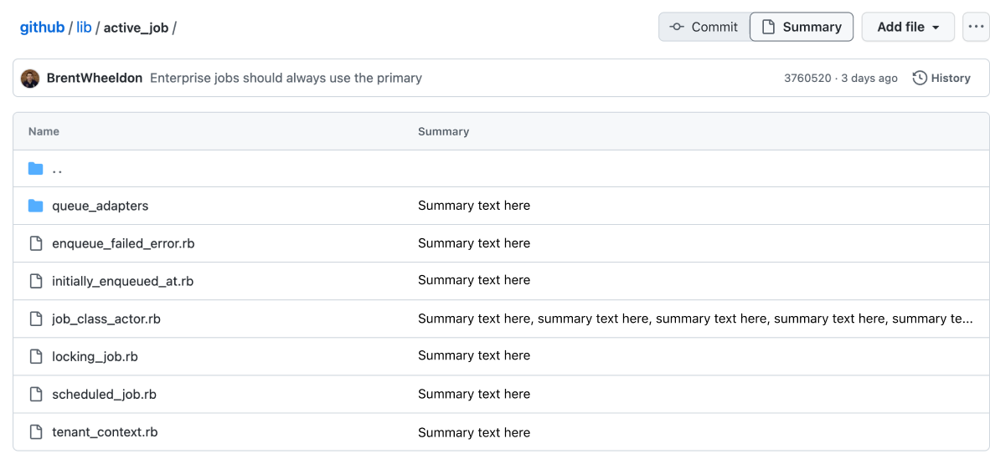
AI Summarization – UX Mockups (EPD Core)

Slide 14
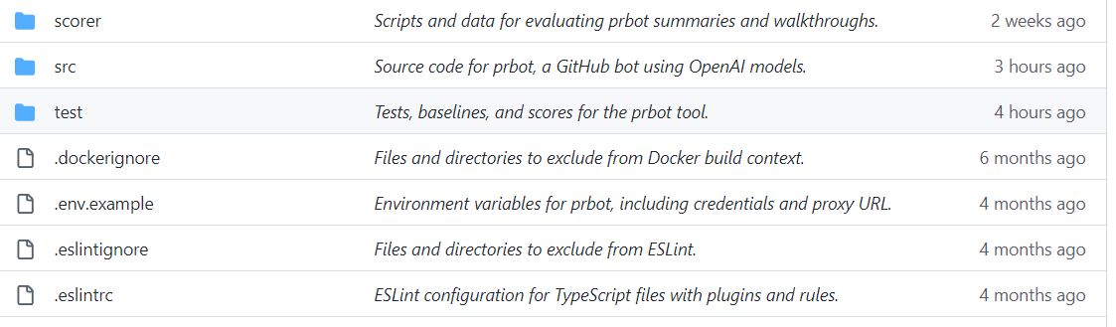
AI Summarization - Sample Short Content

Slide 15
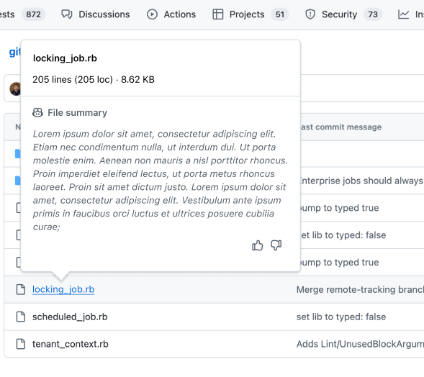

Slide 16
Some Principles of AI Features in GitHub
Utility
Quality
Trust
Handling Change
User Promotion

Slide 17
Principles of AI Features
Utility
The AI outputs must make some human task faster, or better
All new outputs take user attention. They aren’t free.
Quality
Trust
Handling Change
User Promotion

Slide 18
Principles of AI Features
Utility
Quality
The AI makes mistakes, these must be minimized, but still happen
Longer outputs → More mistakes (non-linear?)
The user must either approve/reject or tolerate or not care
Users are more tolerant of mistakes in ephemeral outputs
Trust
Handling Change
User Promotion

Slide 19
Principles of AI Features
Utility
Quality
Trust
Mistakes are highly corrosive to trust
Authorship must be understood
The user must understand that they are reading AI outputs
A human can explicitly take ownership after checking (cf. TAB in Copilot)
Handling Change
User Promotion

Slide 20
Principles of AI Features
Utility
Quality
Trust
Handling Change
Like search, AI outputs should be time-labelled, fresh and up-to-date
User-editing of outputs is often requested but conflicts with change
User Promotion

Slide 21
Principles of AI Features
Utility
Quality
Trust
Handling Change
User Promotion
AI outputs labelled until explicitly promoted
In editor: ghost suggestions, gesture (e.g. TAB) to accept
Out of editor: thumbs-up/down, edit, approve

Slide 22
Thank you!
dsyme@github.com

